Slide 1

Galaxies
By: Grant wiese
james frebes
Kavell jumaa

Slide 2
Background AND MOTIVation
This project serves the purpose of finding and classifying galaxy shapes with a neural network model and a machine learning classifier by creating an algorithm that takes a galaxy and categorizes it into subcategories, compare it to training data to see if it was successful. It also outputs a prediction accuracy.
The research question we aim to answer is: which model is better suited for classifying galaxies?

Slide 3

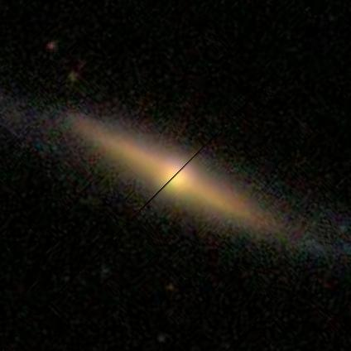
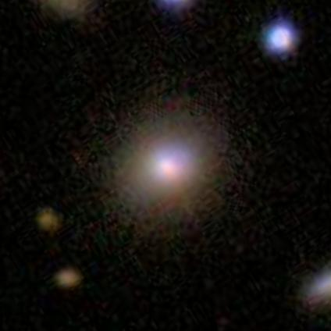
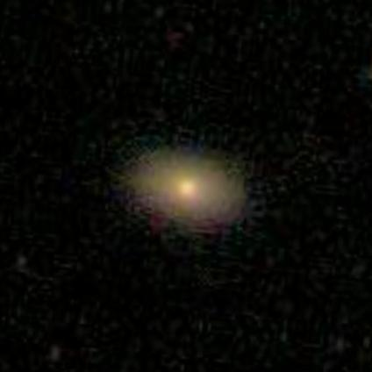
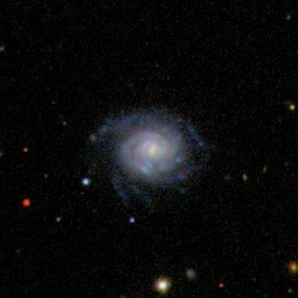
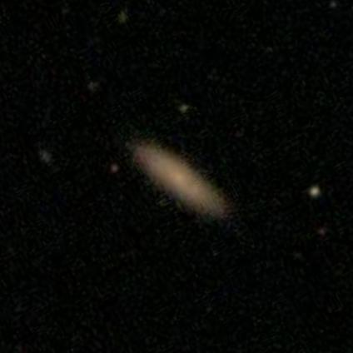
Galaxy classes
Edge On
Round
In between
Face
Cigar Shaped
Edwin Hubble discovered that just about any galaxy in the universe will have one of 4 different shapes, spiral, elliptical, lenticular, and irregular.

Slide 4
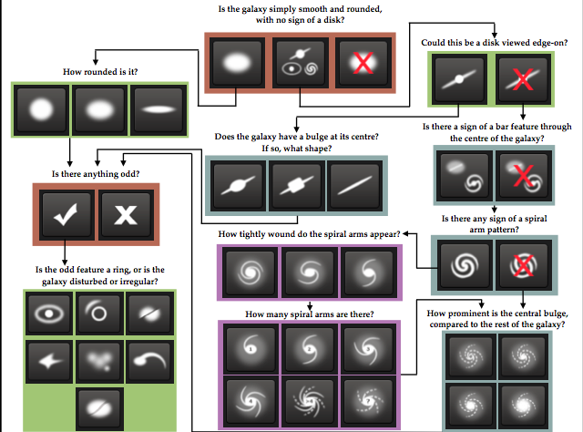
DATASET BAckground
“Galaxy Zoo is a crowdsourced astronomy project which invites people to assist in the morphological classification of large numbers of galaxies. It is an example of citizen science as it enlists the help of members of the public to help in scientific research.”
“Galaxy Zoo.” Wikipedia, Wikimedia Foundation, 3 Apr. 2021, en.wikipedia.org/wiki/Galaxy_Zoo.
“Galaxy Zoo - The Galaxy Challenge.” Kaggle, www.kaggle.com/c/galaxy-zoo-the-galaxy-challenge/overview/the-galaxy-zoo-decision-tree.

Slide 5
Classification: Convolutional Neural Networks
A neural network is like other supervised classification techniques such as a perceptron as a way of training weights to then classify datapoints based on their features. A neural network however is an upgrade to that idea by introducing many interconnected weights which an input is fed through to eventually be classified. The more data a neural network sees, the greater its ability is to identify patterns in inputs
What is a Neural Network?
The convolutional part of a CNN classifier is a way to find important parts of an image to feed into the neural network. Since neural networks take a lot of processing time, this step is almost necessary for any high-resolution image Think of it as a form of feature extraction, in which the program expands the input into a one-dimensional list of important values that can be read into a neural network efficiently
What does convolutional mean?

Slide 6


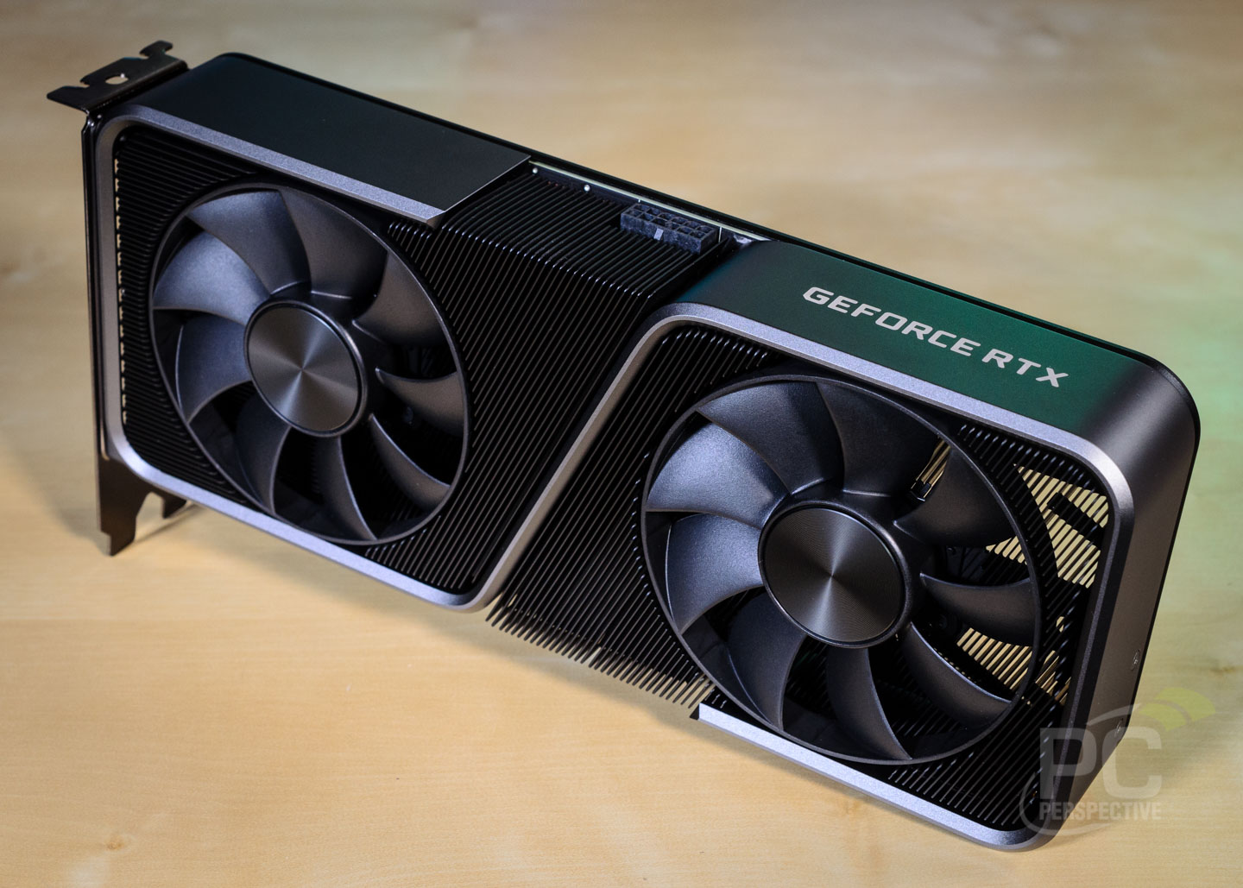
Neural Network Architecture
PyTorch is a package designed for hardware accelerated deep learning production and deployment. It functions very similarly to TensorFlow, but can be integrated with a CUDA computing platform for faster and more efficient training.

Slide 7

CNN Architecture
This is a cat
cat
dog

Slide 8
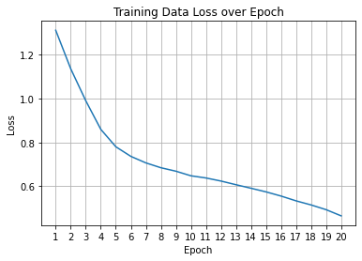
Neural Network Results
- Trained on all ~38000 images
- Batches of 50 images
- 1.5 hours to complete training
When fitted with the validation data set, the CNN classifed the images with 83% accuracy

Slide 9
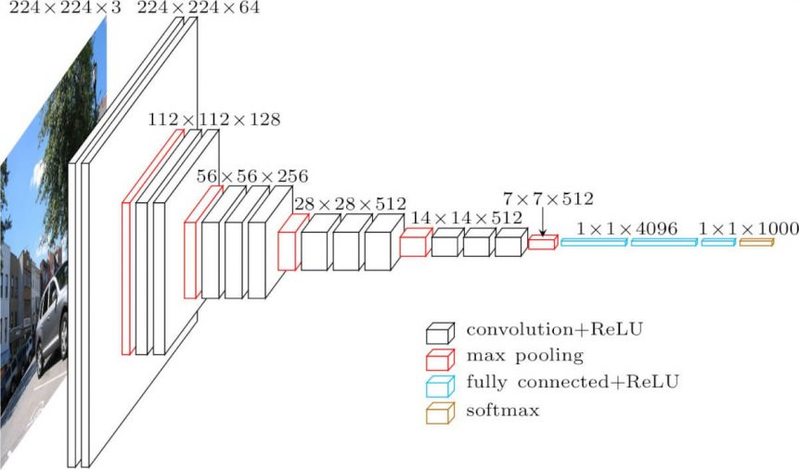
Neural Network: Extra Content
VGG-16 is a convolutional neural network that was trained to classify 10000 classes of images based off a training set of 15 million high resolution images. (92.7% acc!)
Since the network is good at classifying images, the same model can be slightly tweaked and applied to many other machine vision problems with a similar accuracy

Slide 10
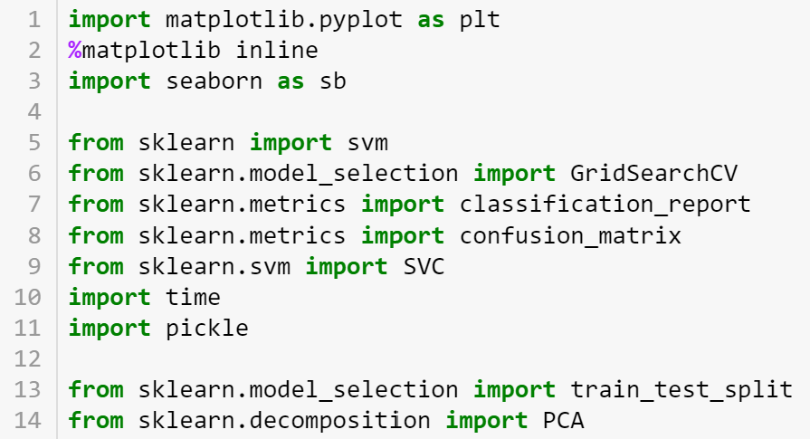
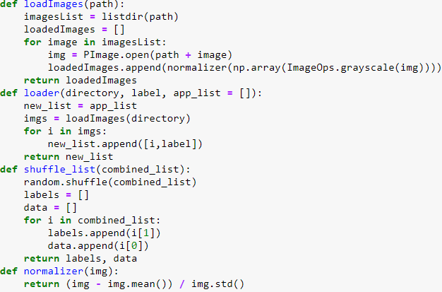
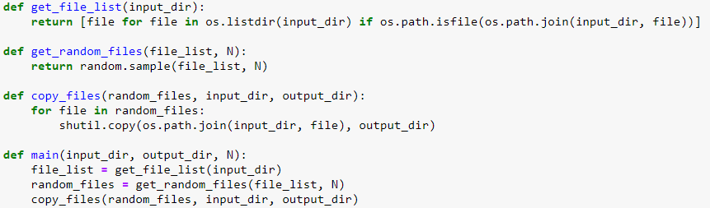
Methodology for machine learning classifier (svm)

Slide 11
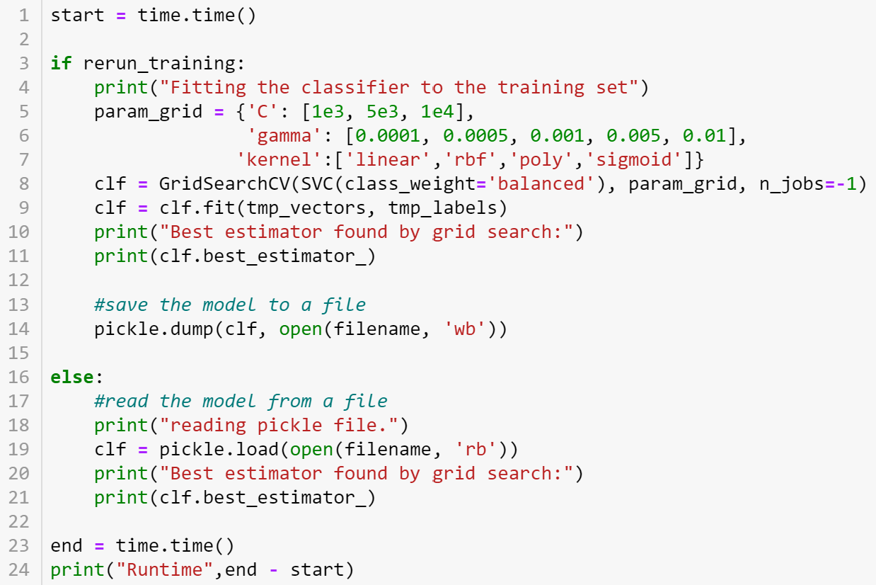
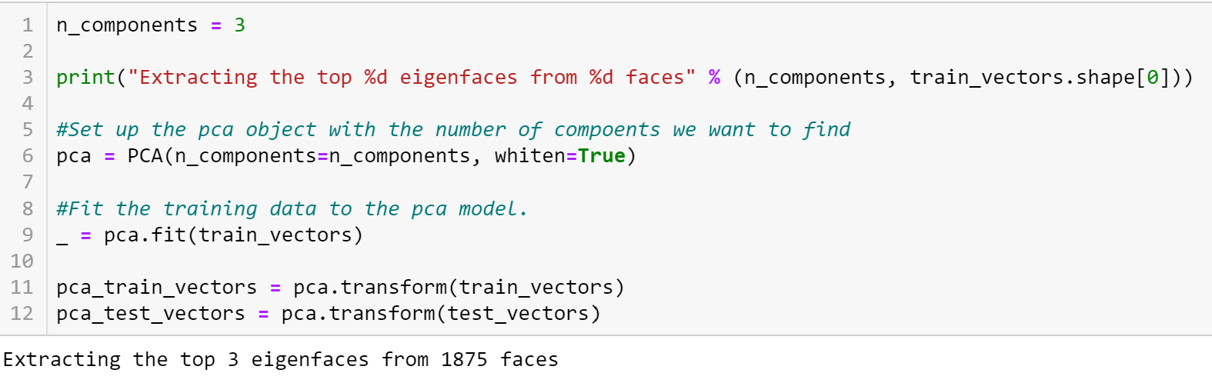
Svm & PCA
Reshaped data into a useable form
Split data into train and testing groups
Used a GridSearch to find the best classifier to fit the training set.
Created a PCA fit then ran it through the GridSearchs

Slide 12
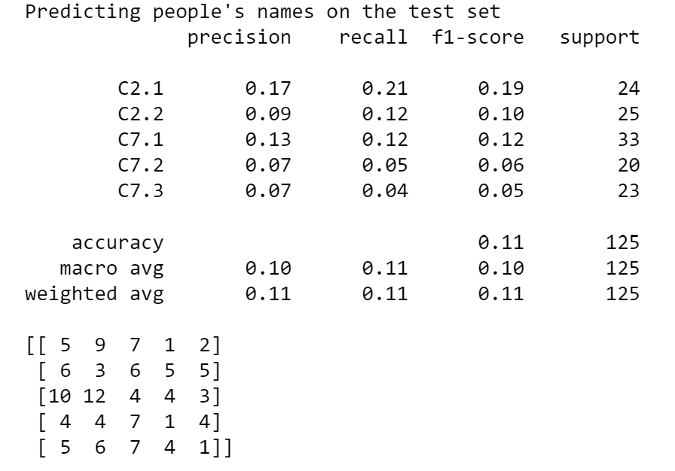
SVM results
Highly inaccurate only 11%
Took an extensive amount of time to load
Smaller data set had to be used

Slide 13
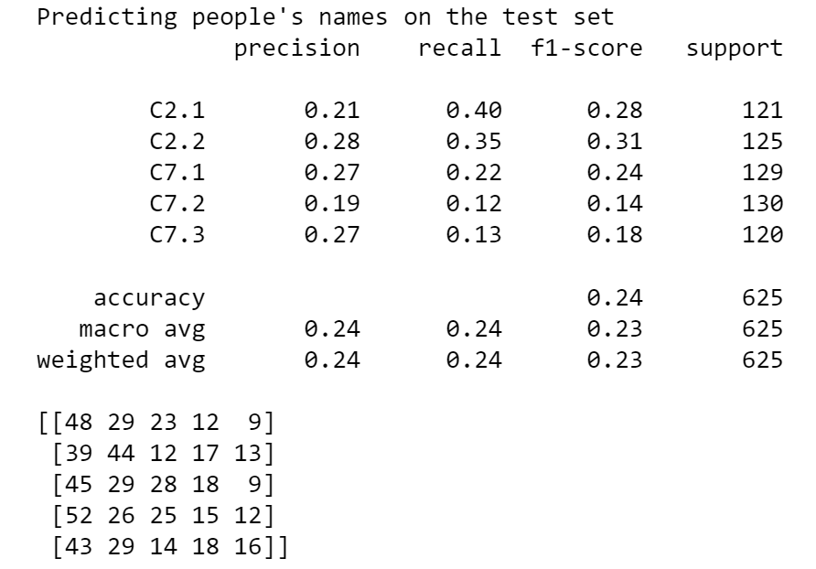
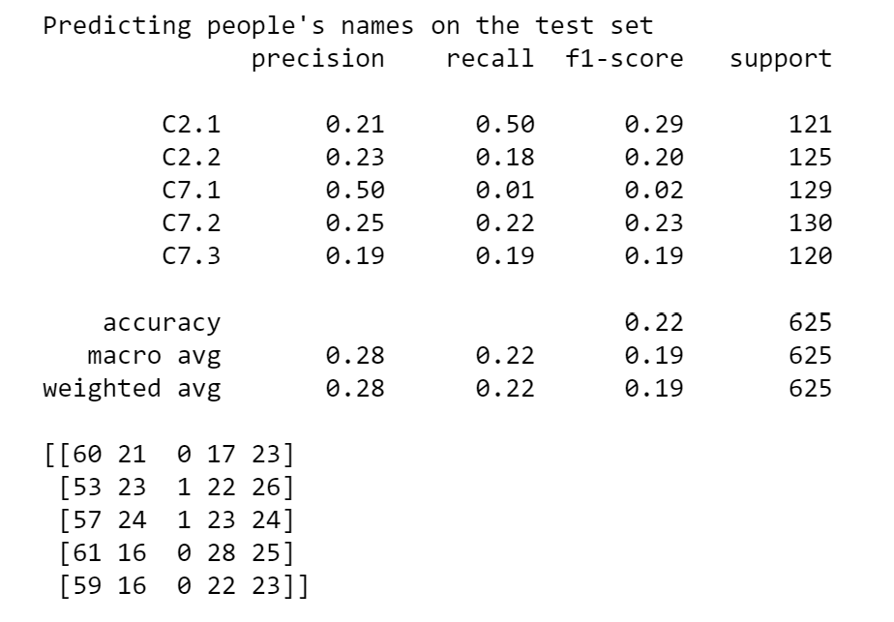
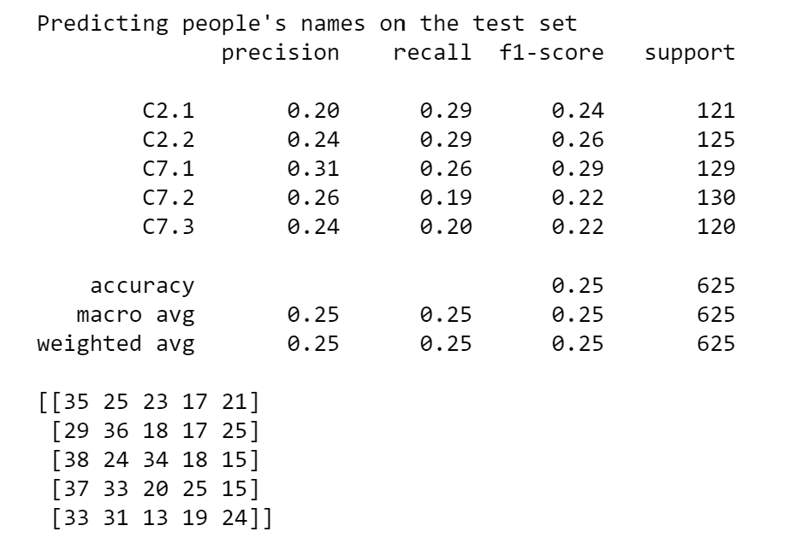
PCA results
Max
80 eigenvectors
71% total variance
26% accuracy
Fluctuated each time it ran
3 eigenvectors
27% total variance
22% accuracy
250 eigenvectors
91% total variance
25% accuracy
Most stable each run

Slide 14

COnclusions
Support Vector Machine
Convolutional Neural Net
Limited use
Computationaly faster while using PCA
Fairly basic machine learning
Our SVM and PCA was not very effective at classifying galaxy images
- Even simple CNN's can be very powerful
- Computationally costly to train
- Represents the cutting edge of deep learning
- Our CNN was quite effective at classifying galaxy images compared to methods that are not tailored to classify images

Slide 15

Limitations on the analysis and what could be improved
- Use higher resolution images that have clearer labels
- Use a more complicated feature selection method for CNN
- Use a pre trained CNN
- SVM could be improved with more trained data

Slide 16
Dataset reference
DATASET FROM KAGGLE
https://www.kaggle.com/c/galaxy-zoo-the-galaxy-challenge/overview/the-galaxy-zoo-decision-tree

